Slide 1
CSIT 200 Week 11 inheritance
Python Programming
LinDa Yang
W-307

Slide 2
outline
Describe inheritance and how it works
Describe the class and subclass relationship
Describe how to override methods
Describe polymorphism

Slide 3
inheritance
Inheritance allows you to create a new class based on an existing class.
A class another class inherits is called the base class, parent class or superclass.
A class that inherits from another class is called a derived class, child class or subclass.
A subclass inherits the public attributes and methods of a superclass, plus it can add its own new attributes and methods. It can also override the methods of the superclass.

Slide 4
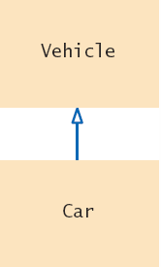
inheritance
In object-oriented programming, inheritance is a relationship between:
A superclass: a more generalized class
A subclass: a more specialized class
The subclass ‘inherits’ data (variables) and behavior (methods) from the superclass

Slide 5
inheritance
General
Specialized
More Specific

Slide 6
inheritance
Since the subclass car “is-a” vehicle
Car shares common traits with vehicle
You can substitute a car object in an algorithm that expects a vehicle object
myCar = Car(. . .)
processVehicle(myCar)
is-a
The ‘is-a’ relationship is represented by an arrow in a class diagram and means that the subclass can behave as an object of the superclass.

Slide 7
inheritance
Use a single class for variation in values, inheritance for variation in behavior
If two vehicles only vary by fuel efficiency, use an instance variable for the variation, not inheritance
If two vehicles behave differently,
Use inheritance
# Car instance variable
milesPerGallon
Be careful not to over-use inheritance

Slide 8
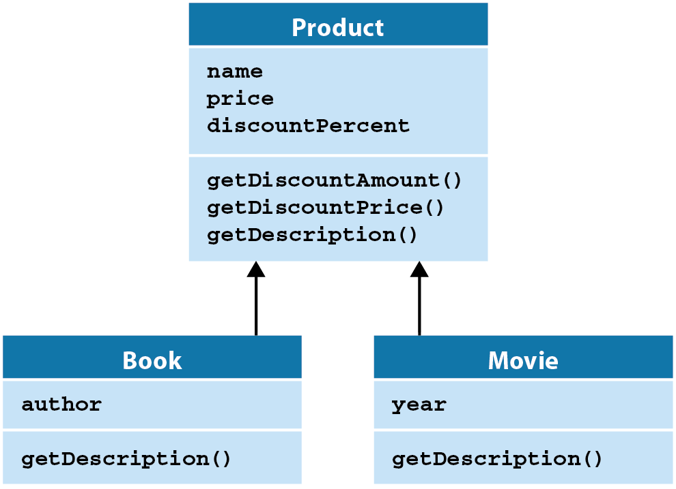
inheritance

Slide 9
Inheritance: Syntax

Slide 10
Inheritance: product superclass

Slide 11
Inheritance: Book suBclass

Slide 12
Inheritance: when coding a subclass

Slide 13
Inheritance: three versions of getDescription()
Polmorphism is a feature of inheritance that lets you treat objects of the subclass as if they were objects of the superclass.
If you access a method of a superclass object and the method is overridden in the subclasses of that class, polymorphism determines which method is executed based on the object’s type.

Slide 14
Inheritance: Using overridden methods

Slide 15
Inheritance: Checking for object type
Sometimes you need to check an object’s type and perform different processing depending on the type.
Use built-in isinstance() function to perform different processing.

Slide 16
Inheritance: Checking for object type

Slide 17
Inheritance: Result of previous code

Slide 18
Inheritance: Product Class

Slide 19
Inheritance: Subclasses: Book() and Movie()

Slide 20
Inheritance: Product Viewer Module

Slide 21
Inheritance: Product Viewer Module

Slide 22
Inheritance: Product Viewer Module

Slide 23
Inheritance: Result of Product Viewer

Slide 24
inheritance
In python, every class that is declared without an explicit superclass automatically extends the class object

Slide 25
inheritance
For Python 3 and later, a class named object is the superclass for all classes.
Every class inherits from the object class.
To make your own classes, you sometimes need to override some of the methods inherited from the object class.
The __str__() method is one of the most used methods of the object class.
Python automatically calls this method when it needs a string representation of an object.
When you code a class, it is good practice to override the __str__() method of the object class to provide more detailed information of the object. Otherwise it will return a string containing the name of the class and the identifier.

Slide 26
Inheritance: Overriding __str__()

Slide 27
Inheritance: Abstract
Abstract Classes and methods
If it is desirable to force subclasses to override a method
of a base class, you can declare a method as abstract.
You cannot instantiate an object that has abstract methods
Therefore the class is considered abstract (it has 1+ abstract methods)
It’s a tool to force programmers to create subclasses (avoids the trouble of coming up with useless default methods that others might inherit by accident).
In Python, there is no explicit way to specify that a method is an abstract method. Instead, the common practice among Python programmers is to have the method raise a NotImplementedError exception as its only statement:
class Account :
. . .
def deductFees(self) :
raise NotImplementedError

Slide 28
Inheritance: Using isinstance()
Don’t use type tests
Some programmers use specific type tests in order to implement behavior that varies with each class:
if isinstance(q, Car) : # Don’t do this.
…
elif isinstance(q, Motorcycle) :
…
This is a poor strategy.
If a new class such as Boat is added, then you need to revise all parts of your program that make a type test, adding another case:
elif isinstance(q, Boat) :
…

Slide 29
Inheritance: Using isinstance()
Alternative to type tests
Whenever you find yourself trying to use type tests in a hierarchy of classes, reconsider and use polymorphism instead.

Slide 30
Inheritance: When to use it

Slide 31
Inheritance: Summary
A subclass inherits data and behavior from a superclass.
You can always use a subclass object in place of a superclass object.
A subclass inherits all methods that it does not override.
A subclass can override a superclass method by providing a new implementation.
In Python a class name inside parentheses in the class header indicates that a class inherits from a superclass.

Slide 32
Inheritance: Overriding methods Summary
An overriding method can extend or replace the functionality of the superclass method.
Use the reserved word super to call a superclass method.
To call a superclass constructor, use the super reserved word before the subclass defines its own instance variables.
The constructor of a subclass can pass arguments to a superclass constructor, using the reserved word super.

Slide 33
Inheritance: Polymorphism Summary
A subclass reference can be used when a superclass reference is expected.
Polymorphism (“having multiple shapes”) allows us to manipulate objects that share a set of tasks, even though the tasks are executed in different ways.
An abstract method is a method whose implementation is not specified.

